Slide 1



ArcGIS Pro Overview John Fry Parker Hornstein

Slide 2
Agenda
Setting Up
Overview of ArcGIS Pro
Tutorial Data
Demo

Slide 3
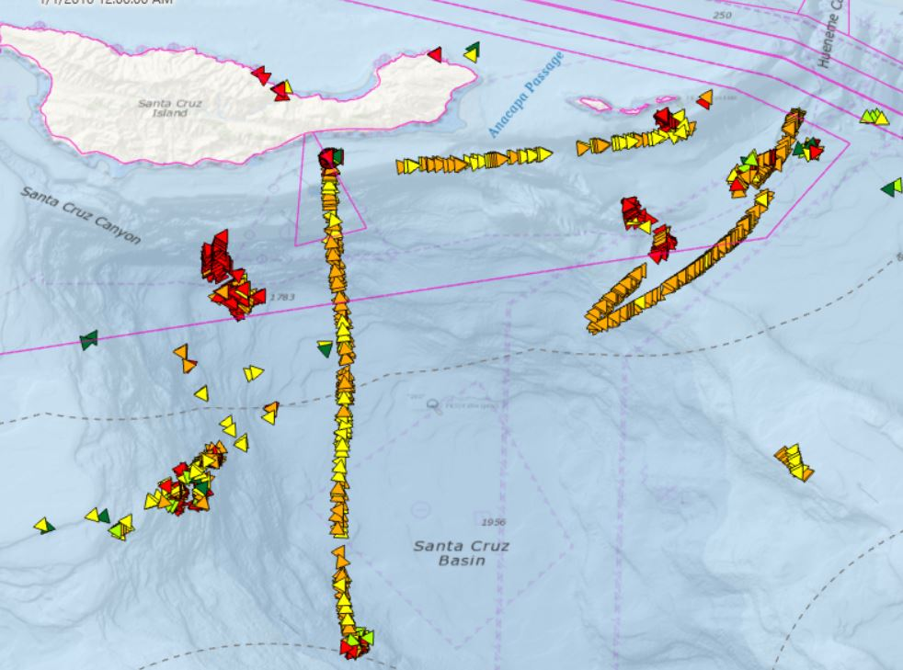
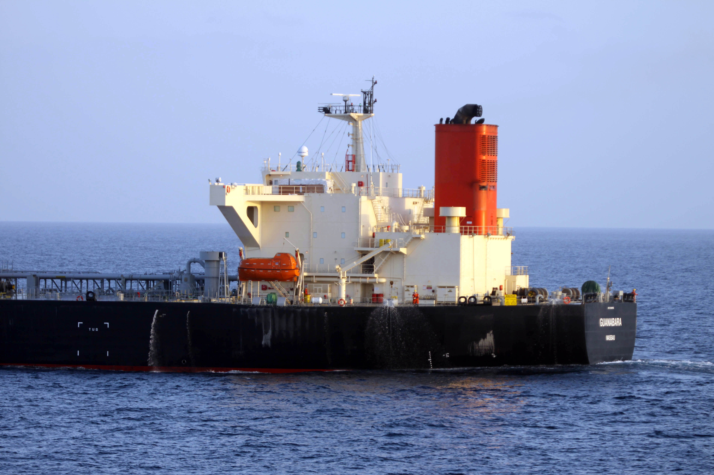
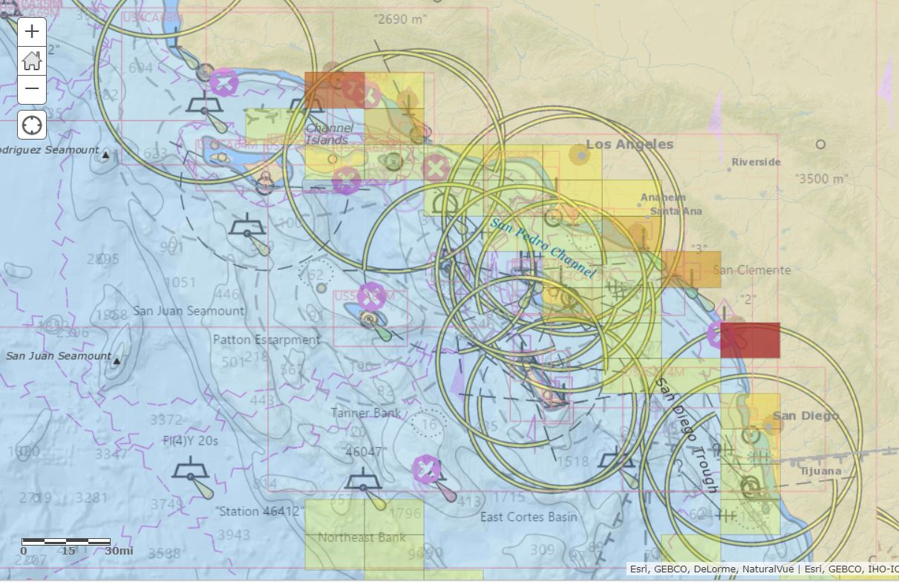
Overview
In Track 2, the ArcGIS platform can be used with other software components to understand complex interactions of vessels at sea

Slide 4
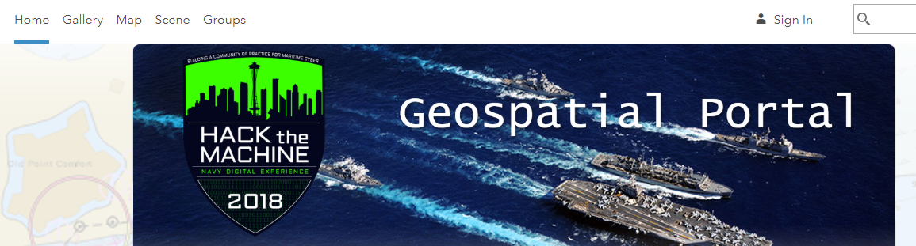
Portal for ArcGIS
Portal for ArcGIS allows users to integrate geographic data and easily create maps and applications to share to others.
Navigate to:
https://htm.esri.com/portal
Press “Sign-in”

Slide 5

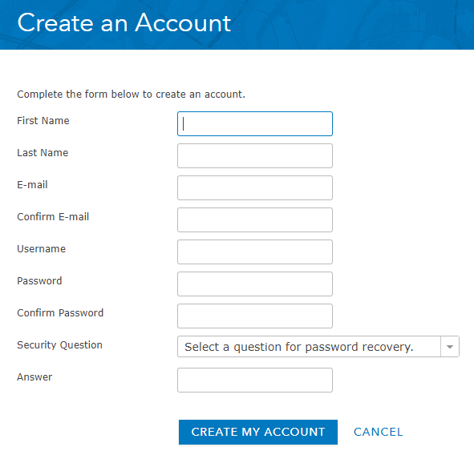
Portal for ArcGIS
By creating an account this will allow you to sign in to other applications across the ArcGIS Enterprise, such as ArcGIS Pro, and the ArcGIS API for Python
Click “CREATE AN ACCOUNT”
Fill out the details
We will give you access to ArcGIS Pro through a named user account

Slide 6
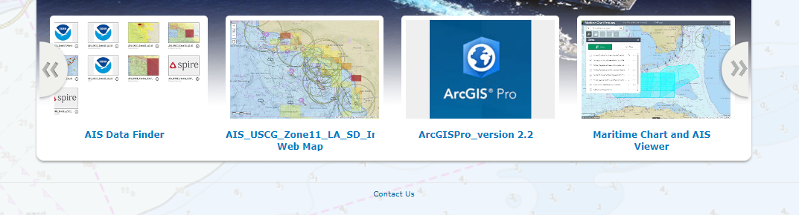
ArcGIS Pro
ArcGIS Pro is a full-featured software package to conduct Geographic Information System (GIS)
analysis and visualization
On the HACKTheMachine Geospatial Portal front page, download ArcGIS Pro

Slide 7
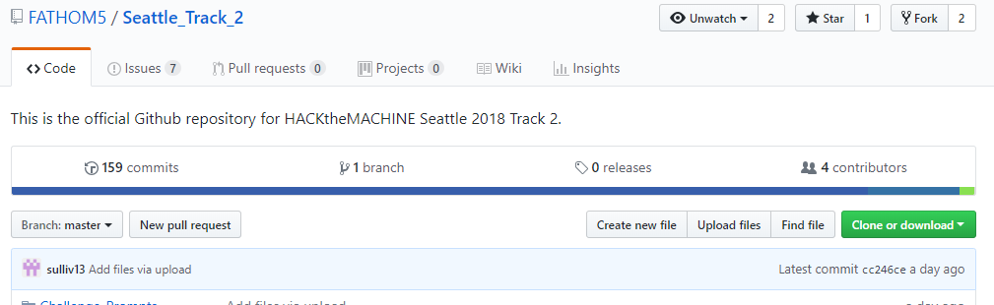
Github
Access to repo allows you to download ArcGIS Pro Tutorial Data
https://github.com/FATHOM5/Seattle_Track_2

Slide 8
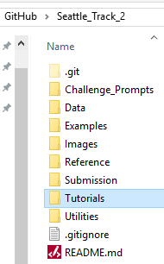
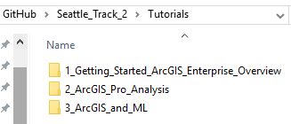
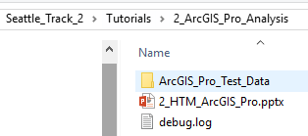
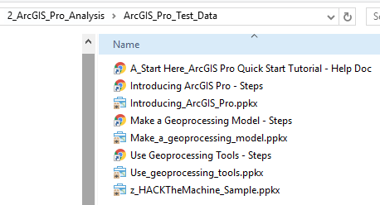
ArcGIS Pro Tutorial Data
Access to repo – ArcGIS Tutorials and Sample Data

Slide 9
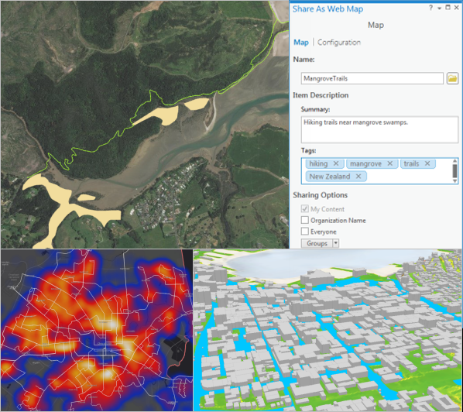
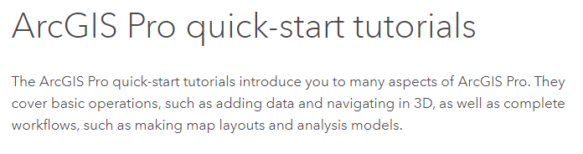
ArcGIS Pro Tutorial Data
ArcGIS Pro Quick Start
Introducing ArcGIS Pro
Introducing ArcGIS Pro Tutorial Data
Use Geoprocessing Tools
Use Geoprocessing Tools Tutorial Data
Make a Geoprocessing Model
Make a Geoprocessing Model

Slide 10
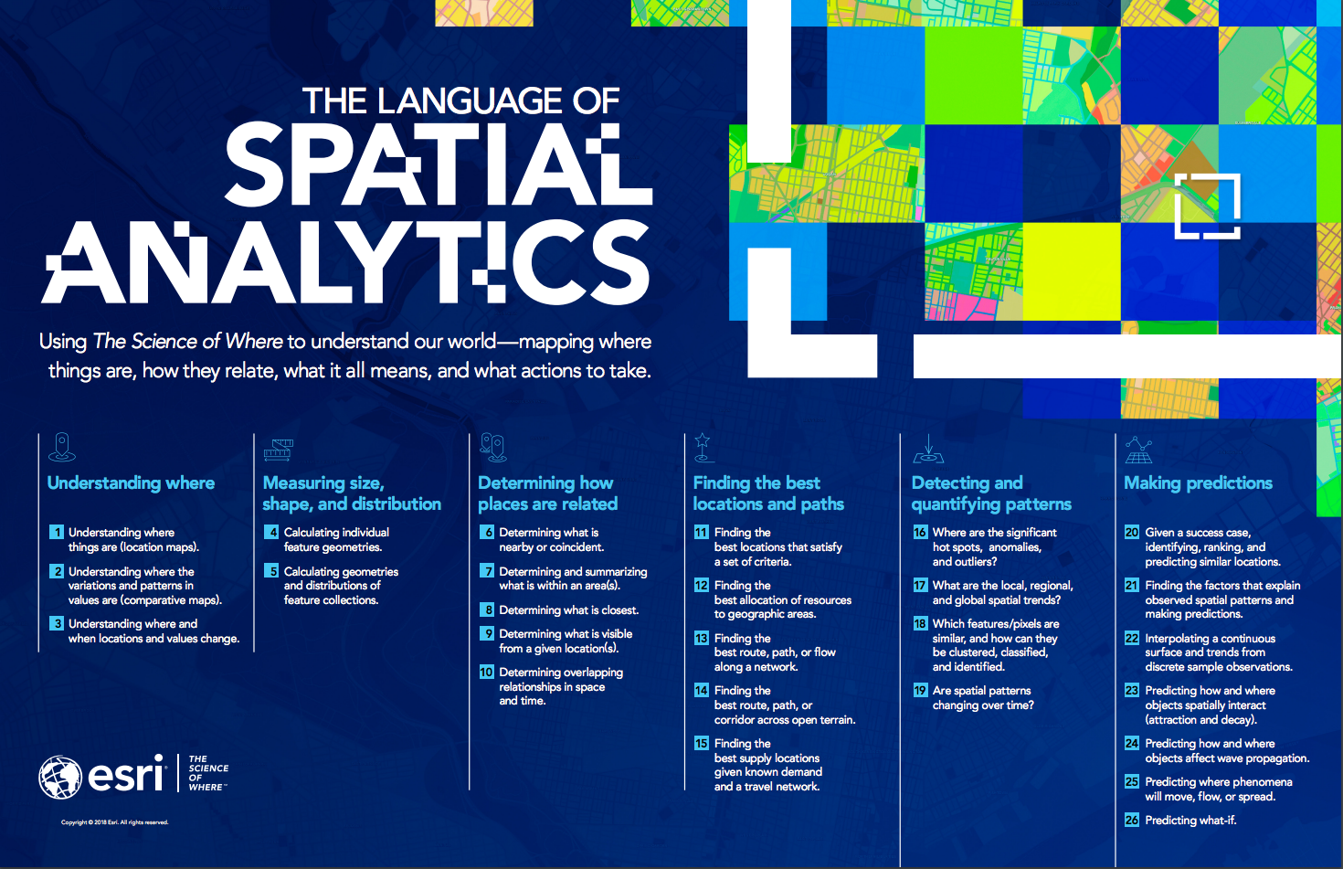

Slide 11
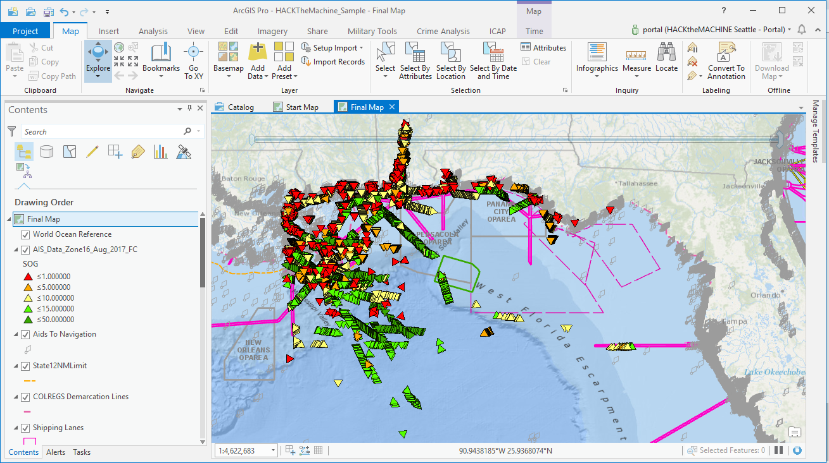
ArcGIS Pro
https://pro.arcgis.com/en/pro-app/
Entry point for GIS users that need to do more
700+ Geoprocessing and Analysis Tools
Share maps and data
Seamlessly work in both 2D and 3D
Multiple Layouts
Fully integrated with ArcGIS Platform
Can be extended with Python, R
Use GeoAnalytics tools

Slide 12
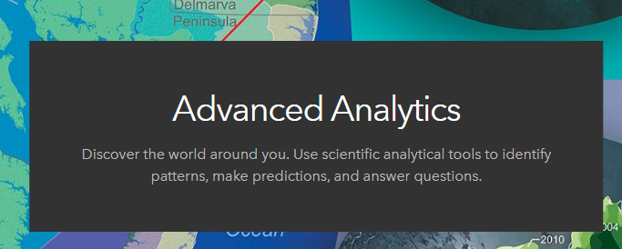
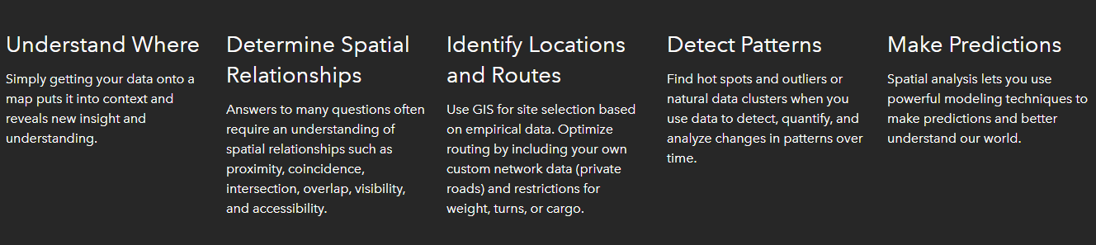
What is ArcGIS Pro?

Slide 13

ArcGIS Pro Integrates with ArcGIS Enterprise
ArcGIS Pro
Desktop
Web
Device
Apps
Portal
Access
Services
Server
Online Content and Services

Slide 14
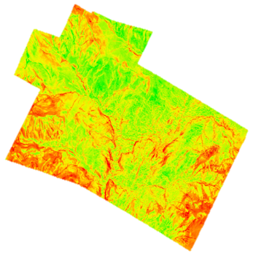
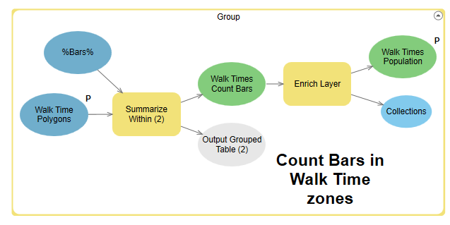
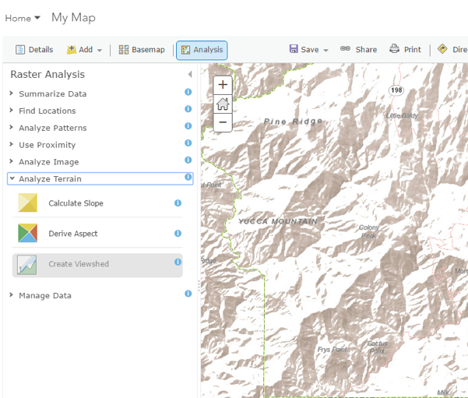
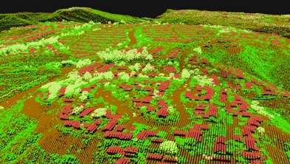
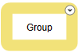
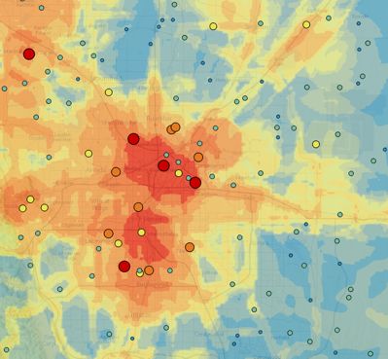
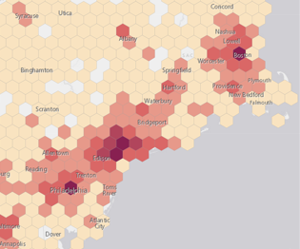
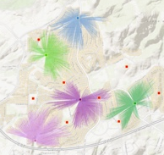

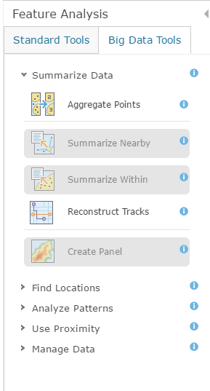

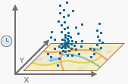
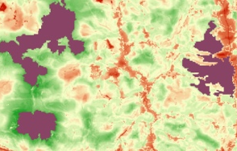
Spatial Analysis
Big Data Analytics
Improved ModelBuilder and Python
Landscape Corridors
Raster
Suitability
Density
Corridors
Distance
EBK Regression Prediction
Topo
Proximities
Classify
Interpolation
Dynamic Aggregation
Difference
Lidar Classification
Vector
Density
Hot Spots
Optimum Site Selection
Buffer
Construct Tracks
Summarize
Find Similar
Improved R Integration
Sampling Tools
Aggregation
Spatial Join
Space-Time Analytics
4D Pattern Mining
Locate Optimum Regions
Notes:
We're also working on other spatial analysis tools. This is a lot of them here. I won't go through them all, but I'll tell you the ones that I really am in love with.
The first one is something called Locate Optimum Regions. This picks out polygons from a suitability surface, like the best place to locate parks or the best place to develop particular land use activities.
The second one is the Landscape Corridor Selection, which might be used, for example, to pick out optimum wildlife corridors.
We're enhancing the spatial statistics dimension and also improving integration with the great open source package called OR. This technology, ladies and gentlemen, has huge implications for us because it means, by building this bridge, ArcGIS users can use the power of R and also R users can use the power of geospatial databases.
On the right of this diagram are two big data analytic tools. These are analyzing massive amounts of data in both raster and vector domains, either from Pro or from browsers.

Slide 15
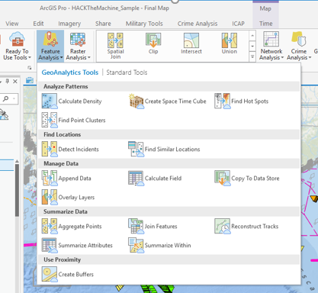
Analysis Capabilities with GeoAnalytics
Extend the capabilities of GeoAnalytics with ArcGIS Pro
Seamlessly use GeoAnalytics results as input to desktop geoprocessing tools
Access Portal items directly from Pro
Use GeoAnalytics tools in ModelBuilder
Result layers can be used with arcpy

Slide 16
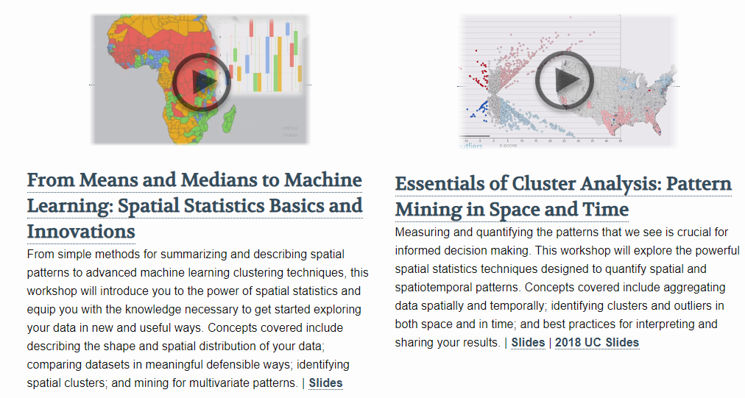

Spatial Statistics
https://spatialstats.github.io/
Presentations, Tools, Tutorials, Add-Ins

Slide 17
Track 2 Challenges – Spatial Questions
Challenge 1: Identifying Interactions between Ships
Out of the millions of data points in the AIS dataset can you find the most efficient algorithm to identify potential collisions?
Where are ships located? What is changing in the AIS data? How close are these to chart features (ie. Shipping scheme)? What is significant in vessel type? What other data can I add to help understand COLREGs? Are there clusters of positive COLREGs?
Challenge 2: Having accurate models of the real-world behavior for ships is a valuable tool for preventing collisions for both manned and autonomous vessels.
What areas are prone to collisions? Are these near a certain type of feature (shipping scheme area, port, etc?)

Slide 18
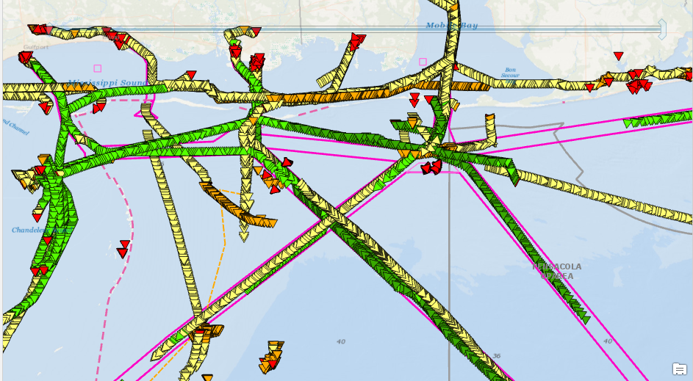
Demo ArcGIS Pro
John Fry

Slide 19


